Slide 1

PURBANCHAL UNIVERSITY SCHOOL OF SCIENCE AND TECHNOLOGY (PUSAT)
A PROJECT REPORT ON QUIZ GAME IN “C”
Prepared by :
Kaushal Raj Trital
Karan Kattel
Md Firoj Miya

Slide 2
EXPLANATION
In this quiz game mini project, you can store the user name, view the highest score secured by a user, and even reset the score. Additionally, to make the game look a little more interesting, it is divided into two rounds; user must pass the first round to reach the second one.
Of the 2 rounds I mentioned above, the first is called the Warm-up Round; the second is the Challenge round. In the warm-up round, the user is asked a total of six simple questions and they must be able to answer at least four of them correctly to enter the next round. If the user is not capable of doing that, he is not permitted to proceed further.
In the second and more interesting round of this quiz game in C, the user will be asked The 23 questions continuously, and for each right answer given, they will earn 100000USD and you will win final amount 2.3M USD.
Game ends when the user’s points. For each question asked, there are 4 options, namely A, B, C and D. There are no negative markings, so the user’s accumulated cash money won’t be deducted for wrong answers to the questions

Slide 3
STRUCTURE OF ALGORITHM FOR PROJECT
Step1: START.
Step2: PRINT GAME NAME AND DETAL TO ENTER.
Step3: ENTER YOUR CHOICE TO ENTER & EXIT ETC.
Step4: DISPLAY GAME RULES.
Step4: DISPLAY AFTER INPUT AND ENTER YOUR NAME.
Step5: ASK 1 TO 6 QUESTIN STEP BY SREP.
Step6: ENTER YOUR INPUT AND CHECK RESULT.
Step7: DISPLAY YOUR RESULT
Step8: CHECK YOUR RESULT THEN DISPLAY NEY STEP ENTRY
Step9: NEXT QUESTIONS SET DISPLAY WITH 23 QUESTIONS.
Step10: RESULT DISPLAY CORRECT OR IN CORRECT & STORE.
Step11: DISPLAY YOR GAME AMOUNT AND RESULT USING DATABASE.
Step12: Stop

Slide 4
SYSTEM REQUIREMENT
Hardware:
-Any type of computer support this file type
-1GB storage
Software:
-Install any IDE(integrated development environment) for C programming with compiler to compile & run.
-We use VSCode for IDE & download Code runner for run the program.

Slide 5
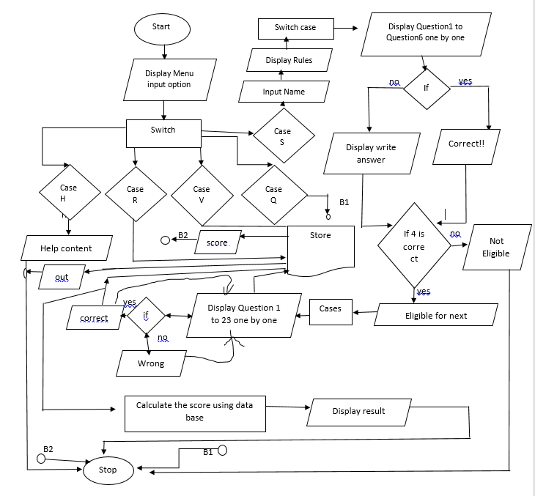
FIGURE OF FLOWCHART FOR PROJECT

Slide 6
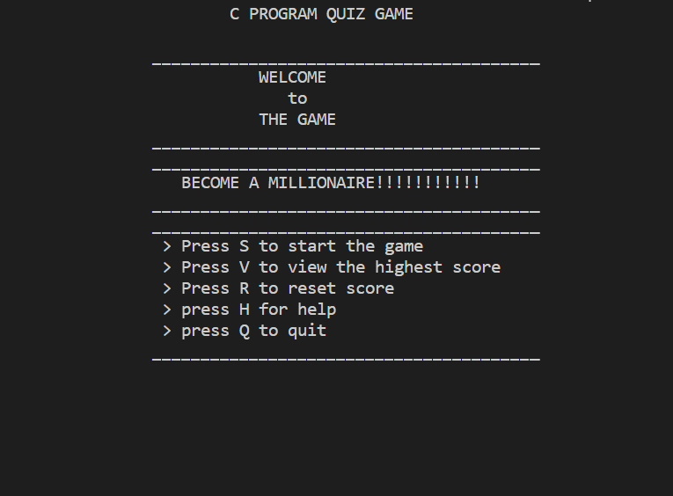
OUTPUT Welcome Page

Slide 7
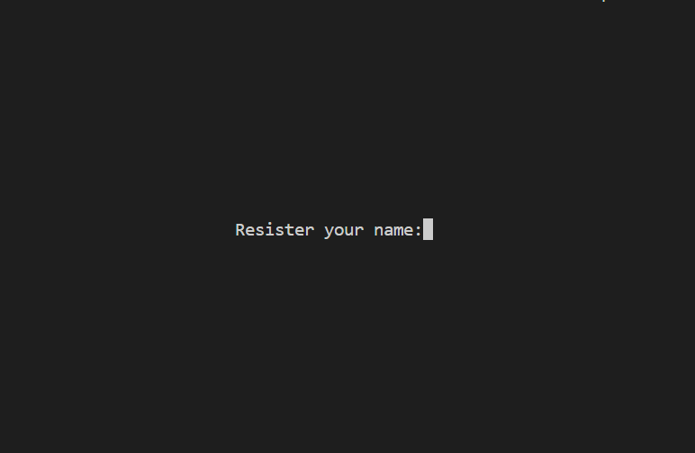
If you enter ‘S’:

Slide 8
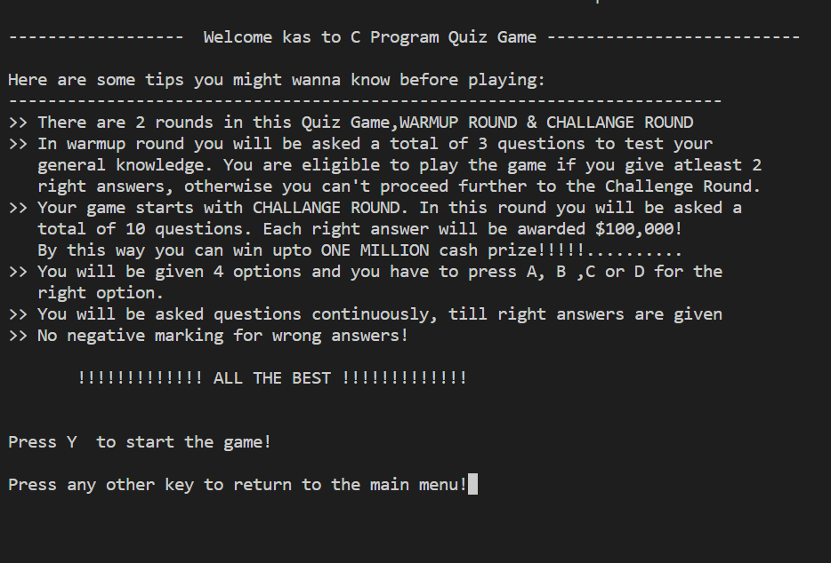

Slide 9
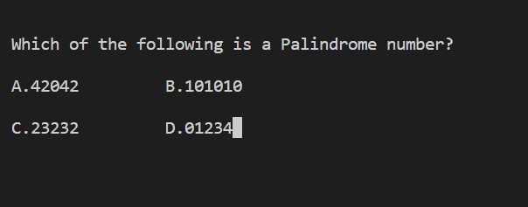
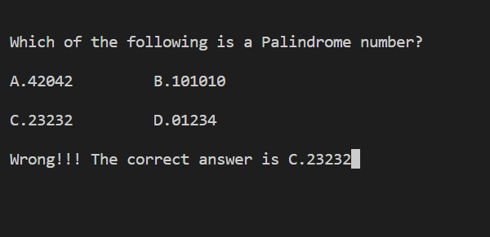
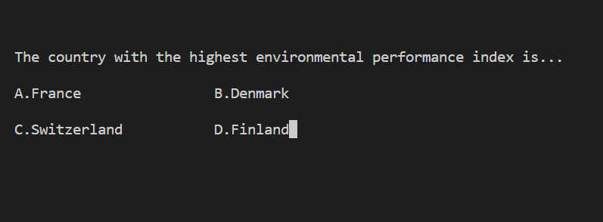

Slide 10
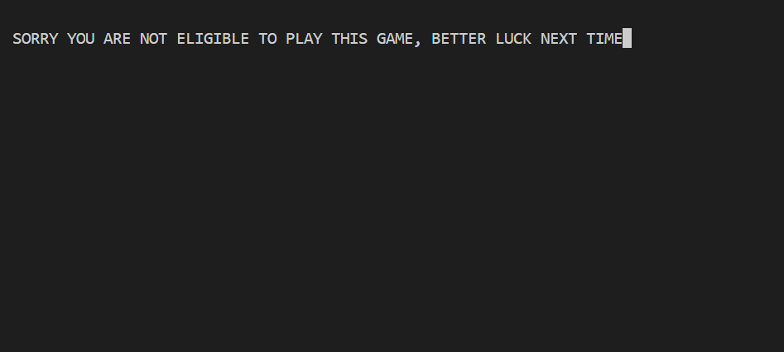
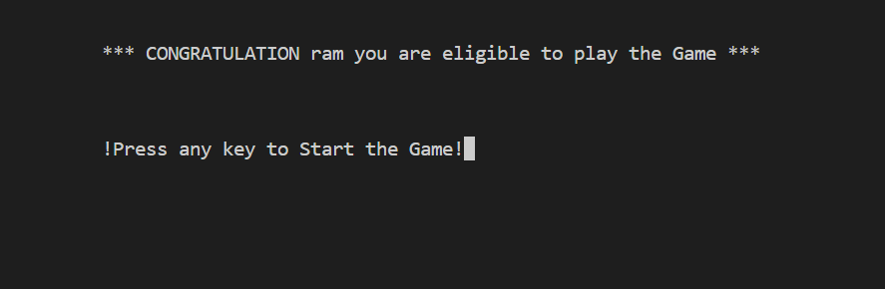
If you correct 2 out of 3 you are eligible for play next money making game :

Slide 11
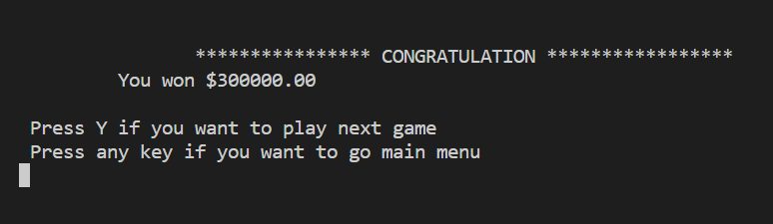
The final result is:

Slide 12
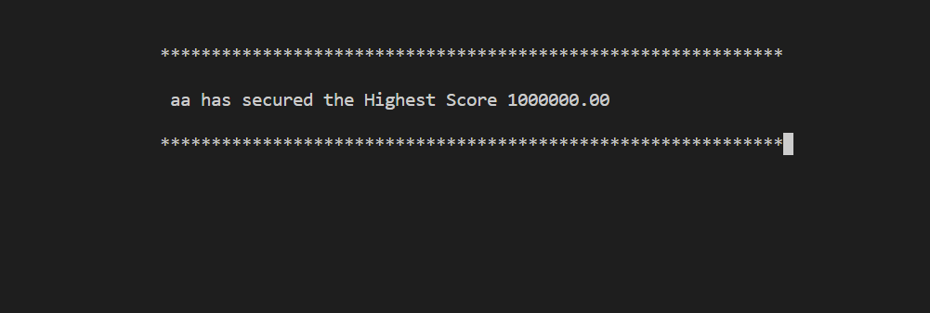
If you enter ‘V’ on first screen:

Slide 13
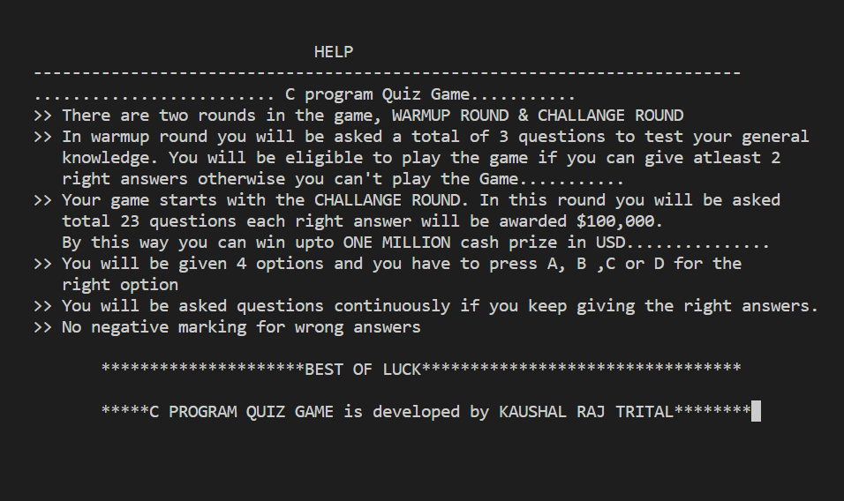
If you enter ‘H’ for help on first screen:

Slide 14
REFERENCE
Books:
Let Us C By Yashavant Kanetkar
Websites:
https://github.com/
https://www.google.com/
https://www.w3schools.com/
https://www.codewithc.com/
https://en.wikipedia.org/wiki/

